Slide 1
Gibbot Frame V4
By Preston Wang

Slide 2
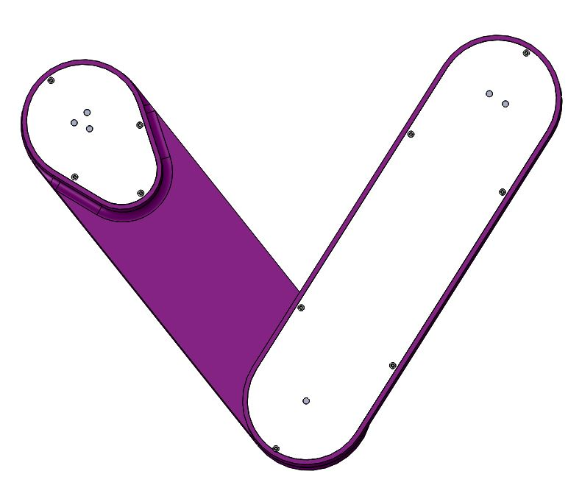
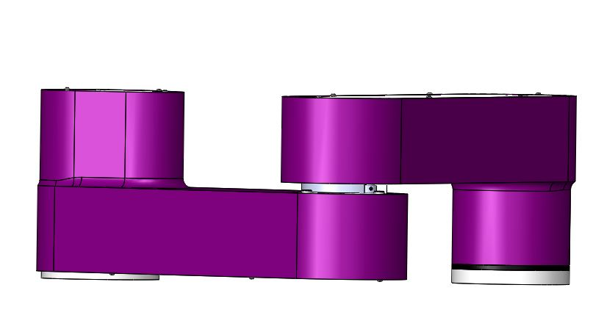
Version 3
Frame Material: ABS Plastic
Manufacture Method: Rapid Prototyped
Length: 9.4 in.
Height: 4.94 in.
Major Design Change: Redesigned Magnet Holder into one piece, Combined Carrier and Shaft into one component, Added Double Bearings at Magnet Holder Connection

Slide 3
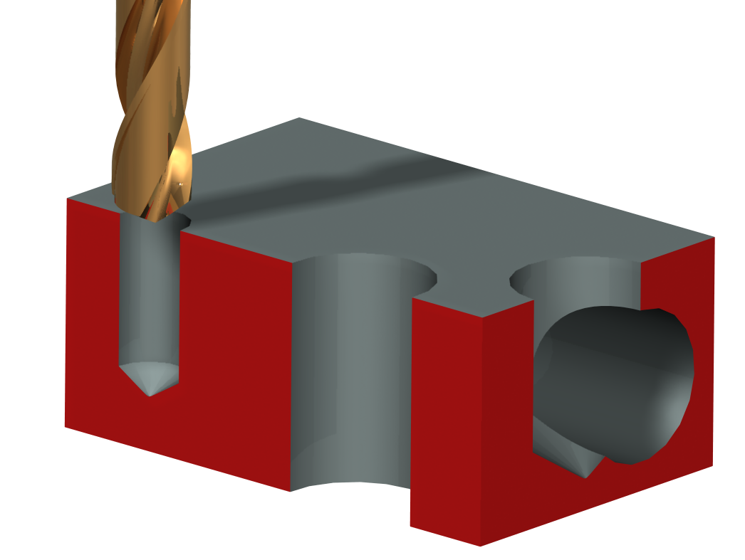
Design Goals
Increase space for wiring
Current frame layout and length does not provide enough space for wires between the motor and board
Increase overall length of frame
Reduce the angular play between links
Change the link connection from a single bearing to double bearing
Increase the stiffness of the connection between the links
Change carrier attachment to frame from blindly threaded screw to nuts and bolts
Verify wall thickness of combined carrier and shaft

Slide 4
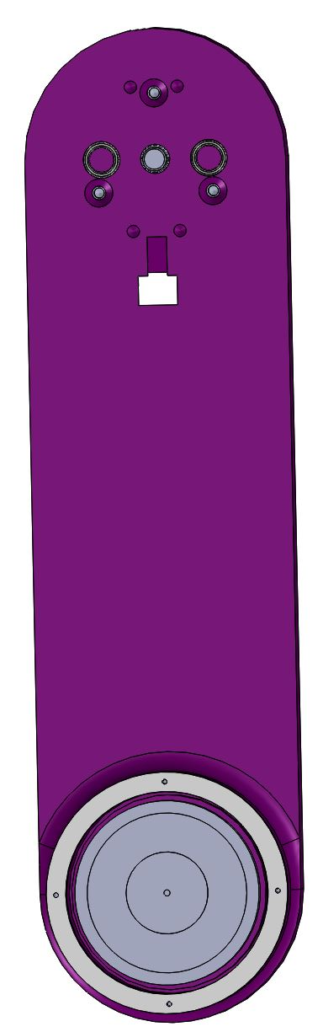
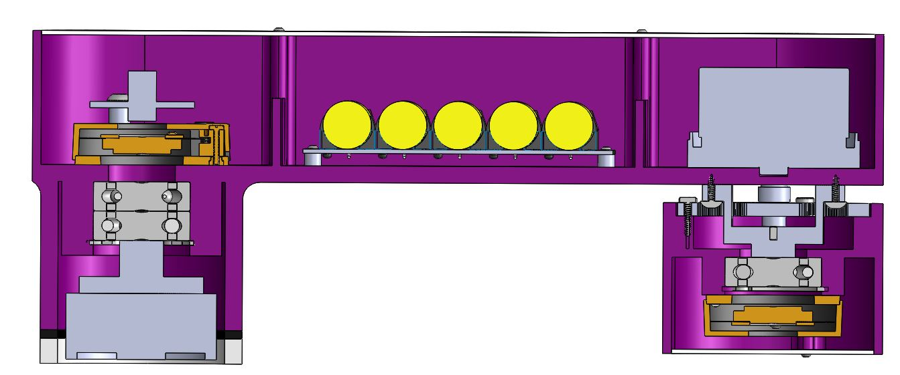
Reason for Changing Gears
Nut and bolt connection requires adequate clearance between fastener and motor
Current ring gear size does not satisfy clearance requirement
Increasing ring gear ID will provide required clearance
Increase spacing between planetary gear bearings and DC Motor fasteners

Slide 5
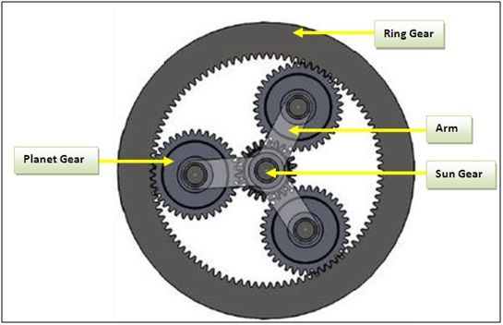
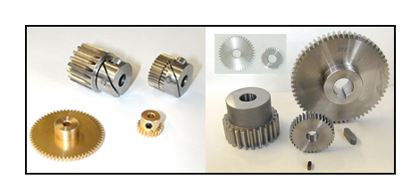
Gear Selection Criteria
Increase Ring Gear ID
Minimum ID is 3.5 in
Maintain same gear ratio of 6
# of revolution of sun gear to revolution of ring gear
Choose planetary gears and sun gear with hubs
Hubs provide means of attaching gears to shafts
Sun gear bore must be 8mm to fit on motor shaft
Verify that gears can withstand max torque from motor

Slide 6
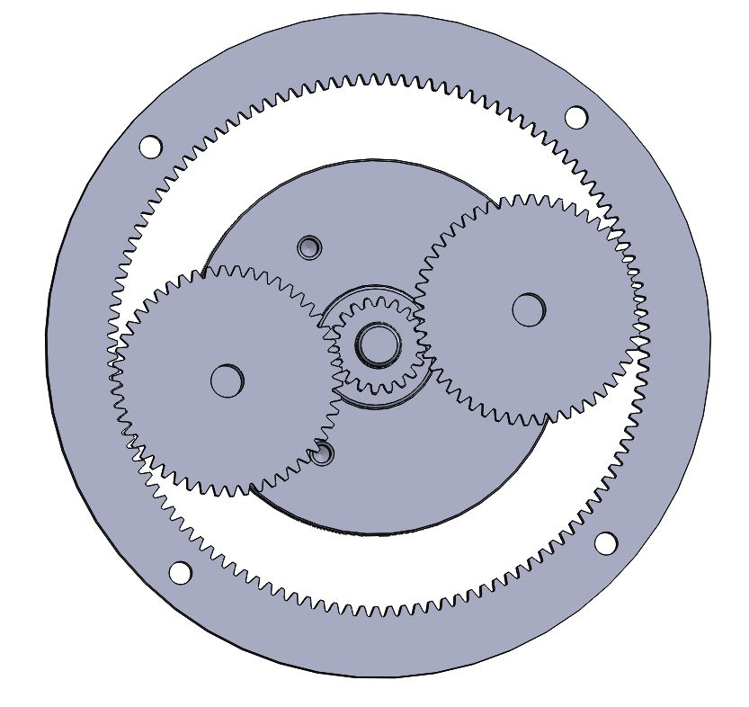
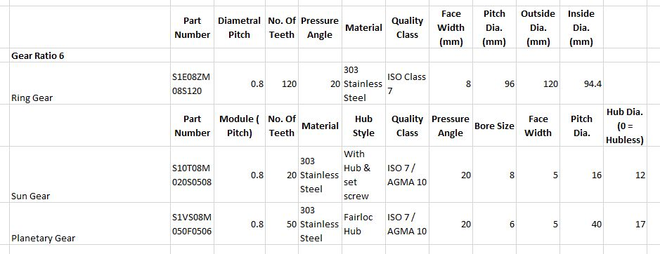
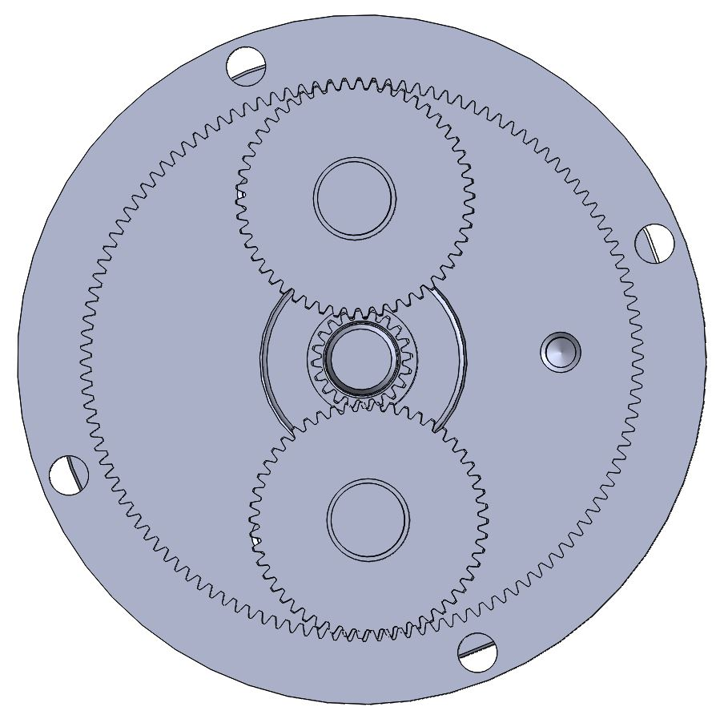
Gear Selection

Slide 7
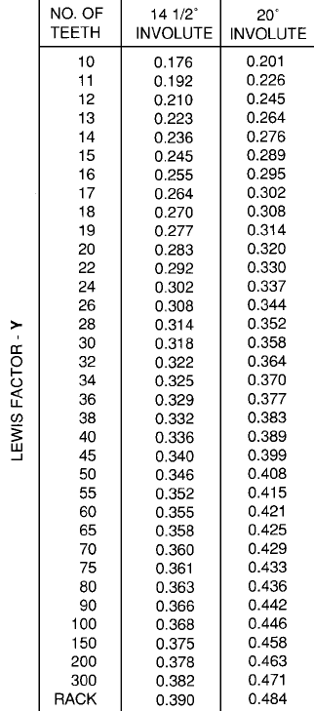
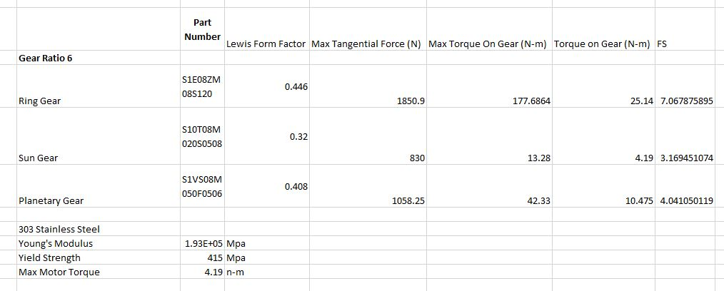
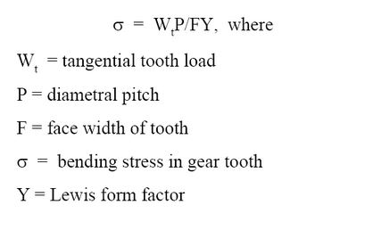
Gear Calculations

Slide 8
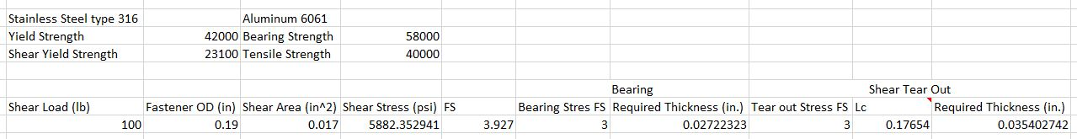
Shaft and Fastener Calculations

Slide 9
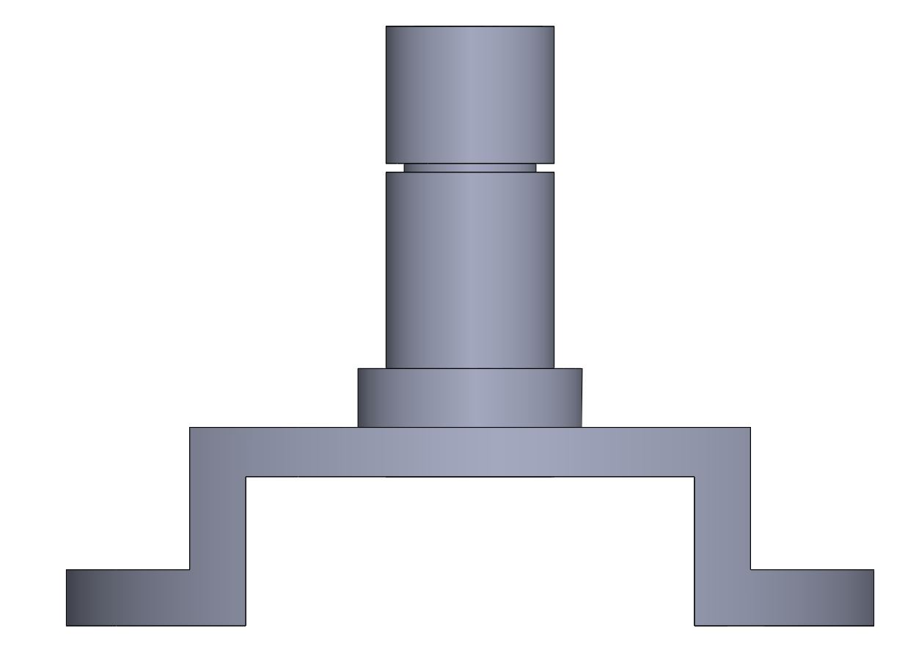
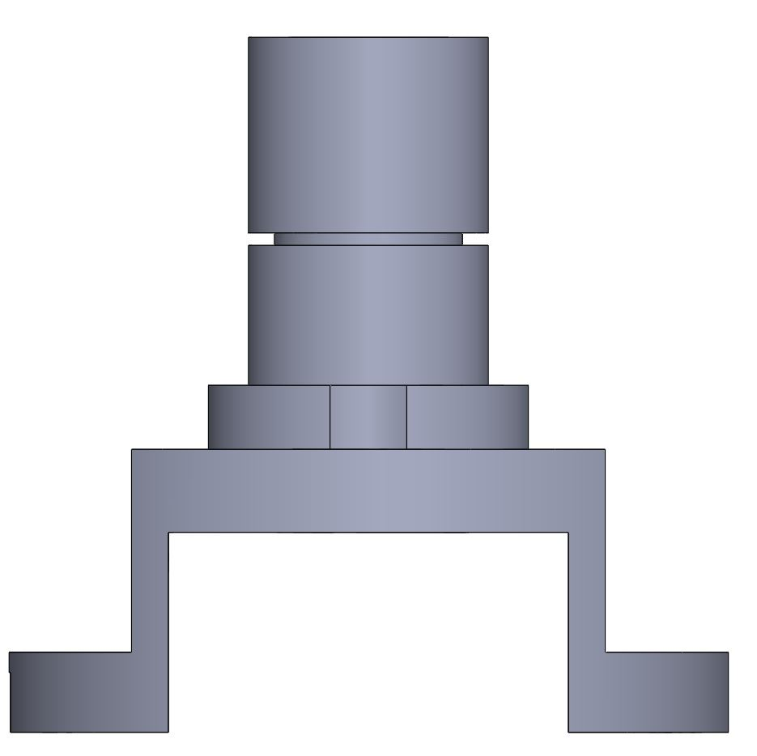
Carrier and Shaft
Changes:
Increased Height to accommodate 2 bearings
Increased width to provide clearance between fastener and DC motor
Changed bearing holes to accommodate 12mm OD bearing
Maintained ¾ in. OD and ½ in. ID on shaft
Can reuse same bearings
Maintains space for wiring

Slide 10
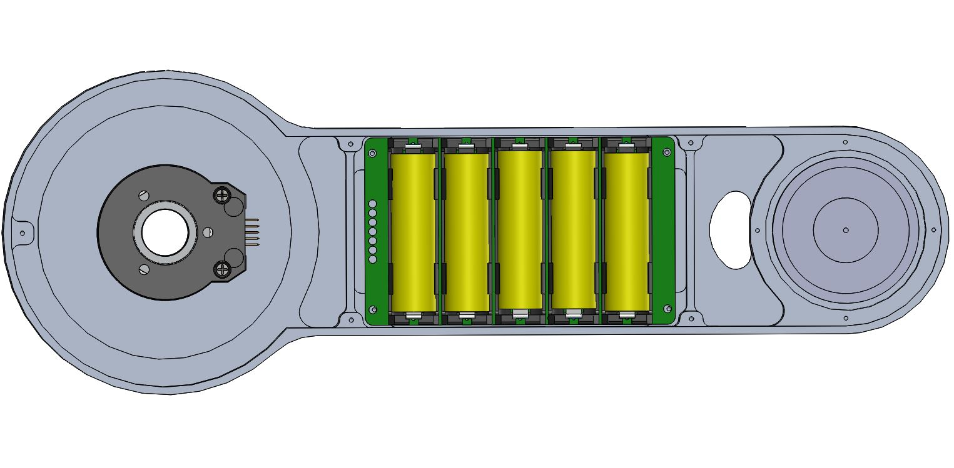
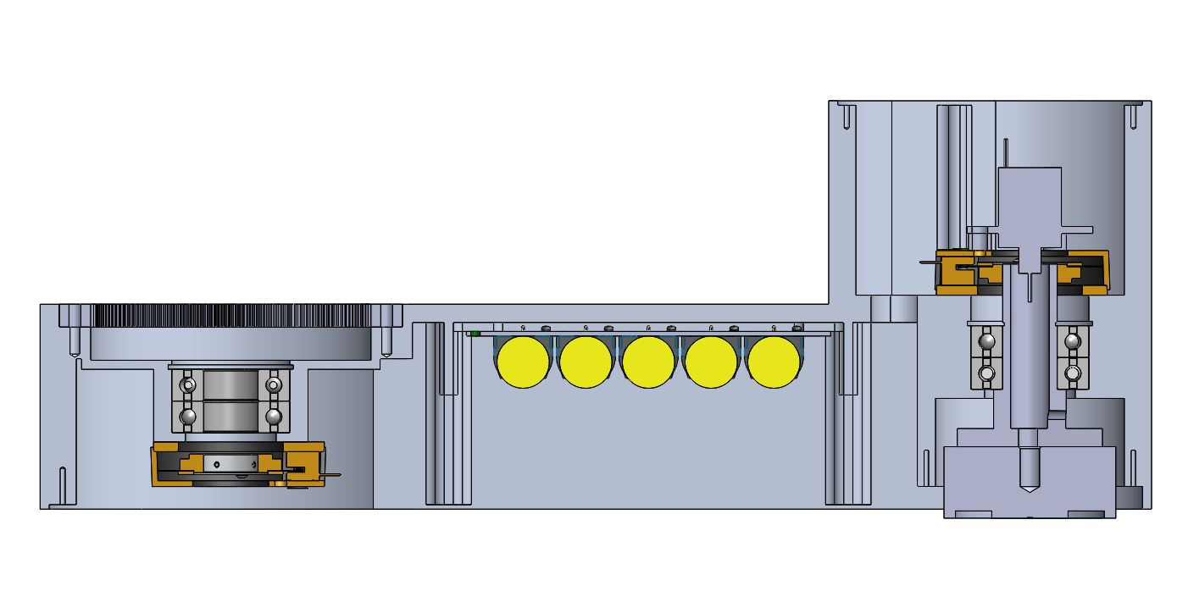
Wall Link

Slide 11
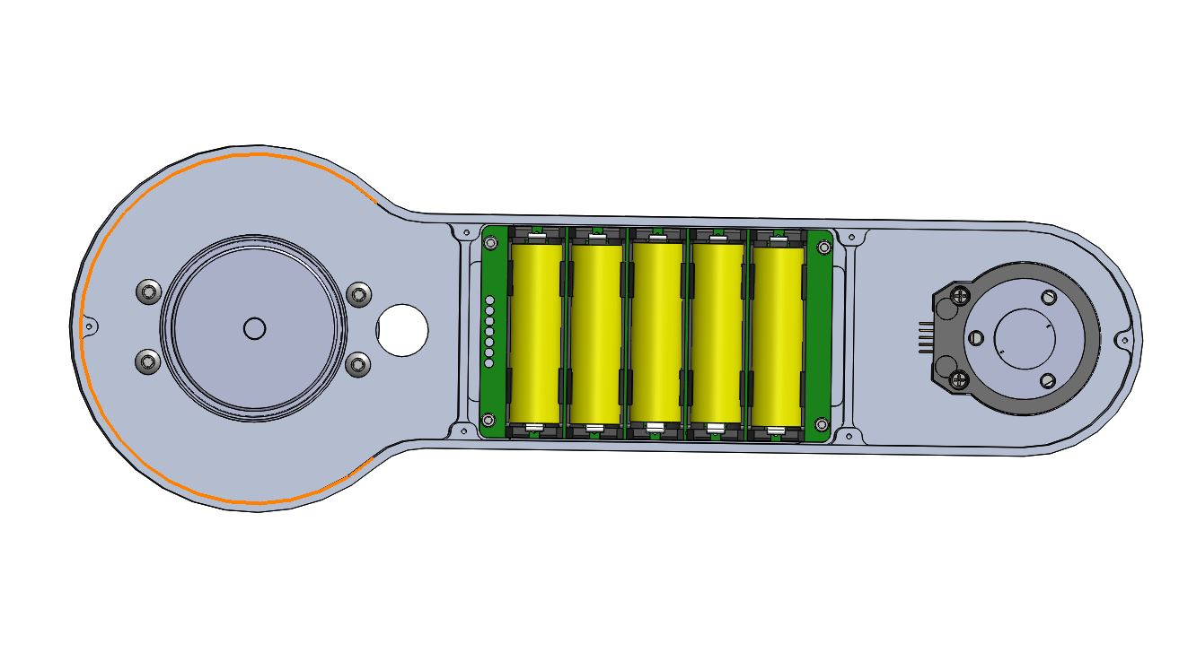
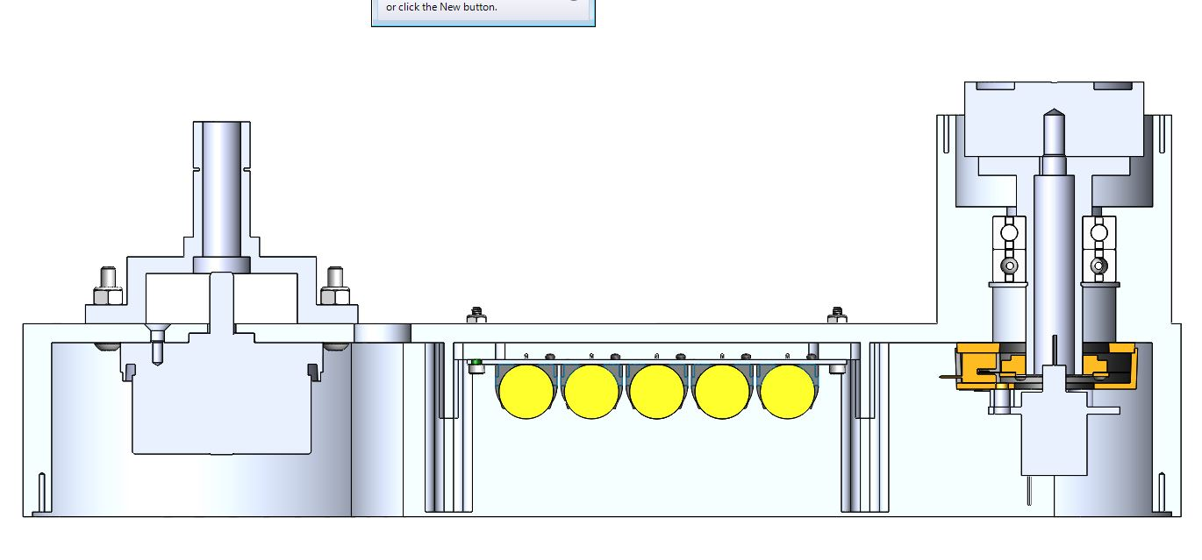
Motor Link

Slide 12
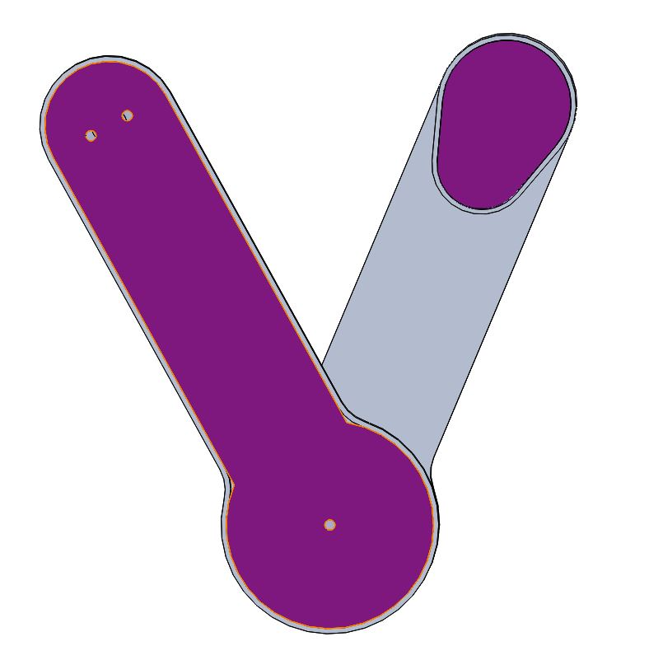
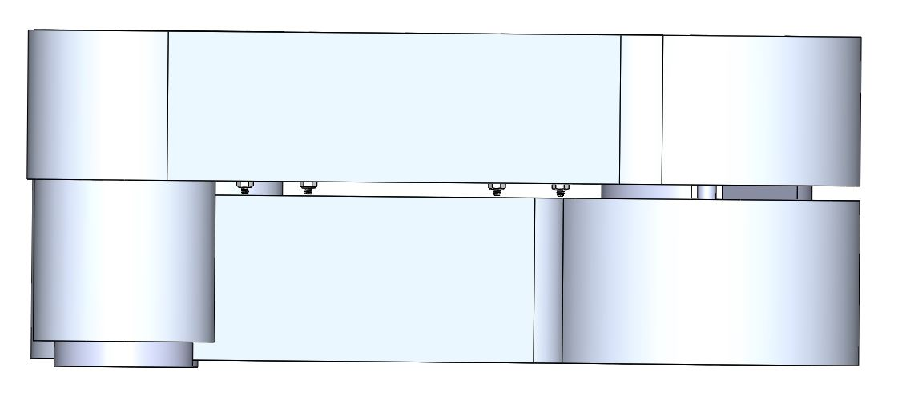
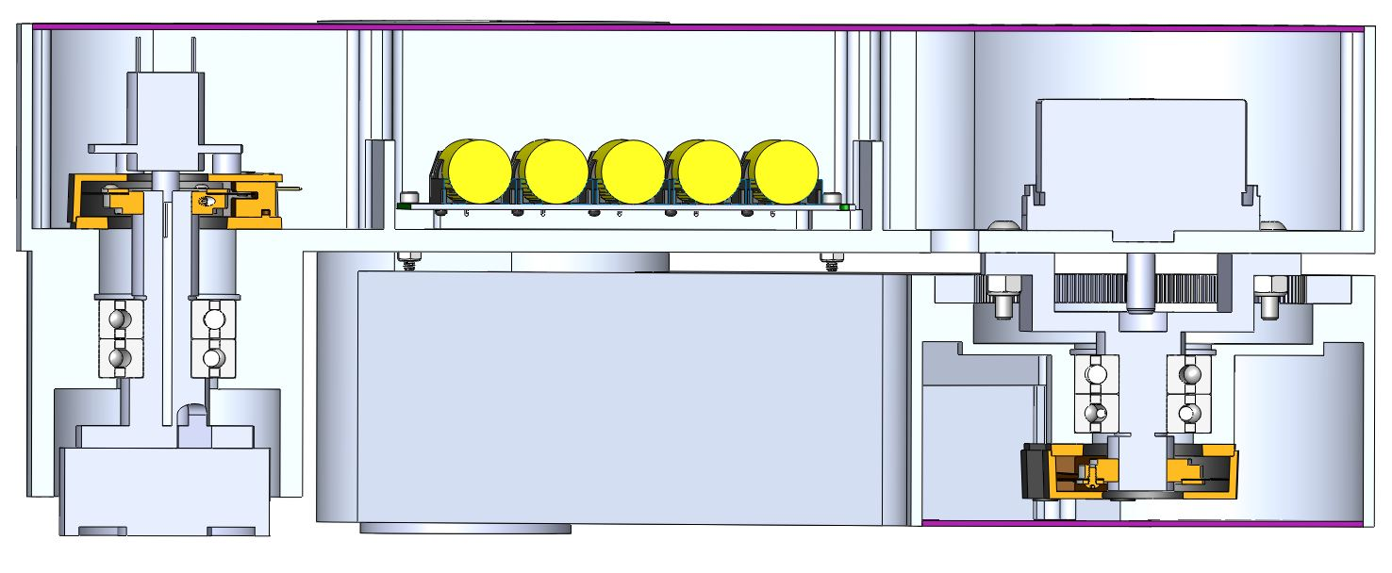
Gibbot

Slide 13
Comparison to Previous Year
Wall Link Weight:
V4: 4.26 Lbs
V3: 1.23 Lbs
Motor Link Weight:
V4: 3.55 Lbs
V3: 0.97 Lbs

Slide 14

Future Steps
Decrease height of Motor and Wall Link
FEA of Links
GD&T of both links
Outsource to Industrial Molds

